Slide 1
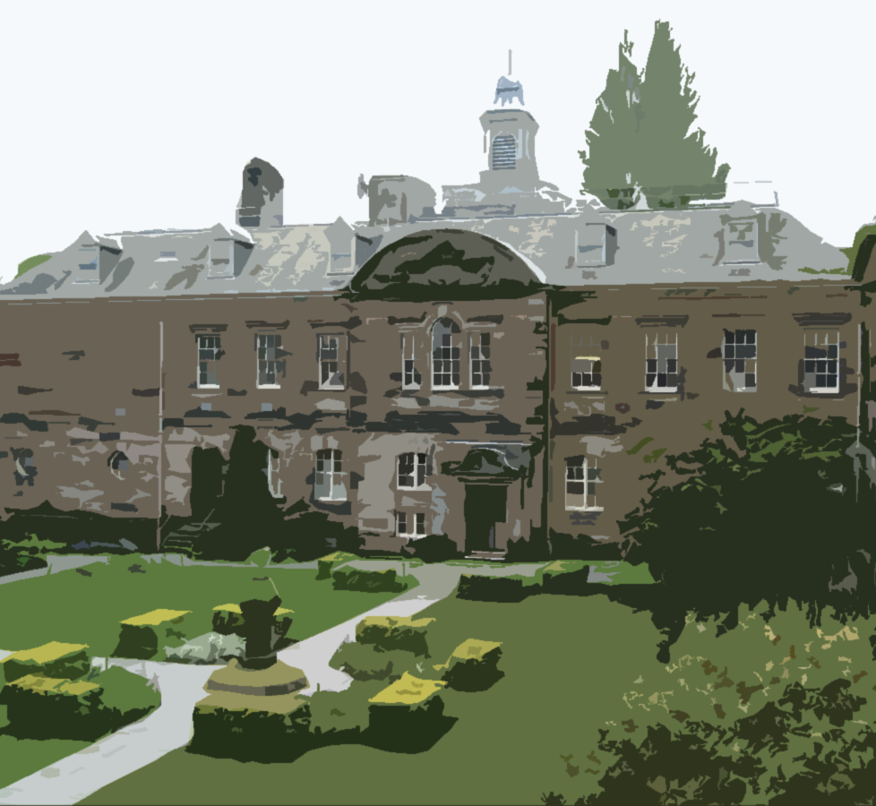


STUDENT
REPRESENTATION
Core Training for incoming
SCHOOL PRESIDENT
VICE-PRESIDENT

Slide 2
LEARNING OUTCOME
ROLE & BENEFITS
EFFECTIVE ENGAGEMENT
CORE REPSONISBILTY
SYSTEM & STRUCTURES
EFFECTIVE FEEDBACK

Slide 3

ICE BREAKER

Slide 4
ROLE SPECIFICATION
The office of School President is one of the most important positions within the student representation system. School Presidents are vital stakeholders who work to enhance the student experience, they are tasked with leading the overall student voice of their academic school.
School Presidents have a vast network of students and staff to work and connect with. They are supported by a committee of Vice-Presidents, each of whom have oversight of their respective disciplines.
The VPs carry out similar duties and help link School Presidents to the Class Representatives.

Slide 5
YOU HAVE OPPORTUNITY TO:
DEVELOP
MEET
GAIN
MAKE
ENHANCE
Develop advocacy, communications and meeting skills
Meet new people and network with different stakeholders
Gain a representative certificate
Make a real difference to your student experience, as well as a positive difference to other students’ lives
Enhance your CV and employability

Slide 6
EFFECTIVE ENGAGEMENT
Care for those you represent and show commitment to student and your roles
Be competent in how you operate and delegate
Be open and professional in your jcommunication

Slide 7
CORE RESPONSIBILITY
SCHOOL PRESIDENTS | VICE-PRESIDENTS
Lead Representation | Deputize and support the President
Represent your students at key committees | Coordinate student feedback at the discipline level
Develop and lead on enhancement projects | Organize and lead SSLC’S
Support Vice Presidents and class reps | Ensure Feedback is communicated

Slide 8
REPRESENTATION STRUCTURE
School President
Senior School Management (ADL&T/Dean/School Manager)
Vice President
Class Representative
Discipline Leads/ADL&T
Staff and Module/Programme Leads
School Board
Learning and Teaching Committee
Students Board
School President Forum
Student Representative Council(SRC)
Student staff liaison committee( SSLC)
SRC

Slide 9
Representation Structure: Students’ Association
Student Representation Council (SRC)
DUSA Executive
School Presidents
SRC Councillors
DUSA
Students
Class Reps/Vice President Feedback

Slide 10
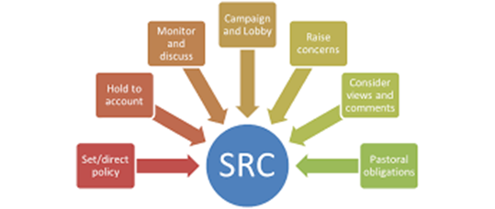

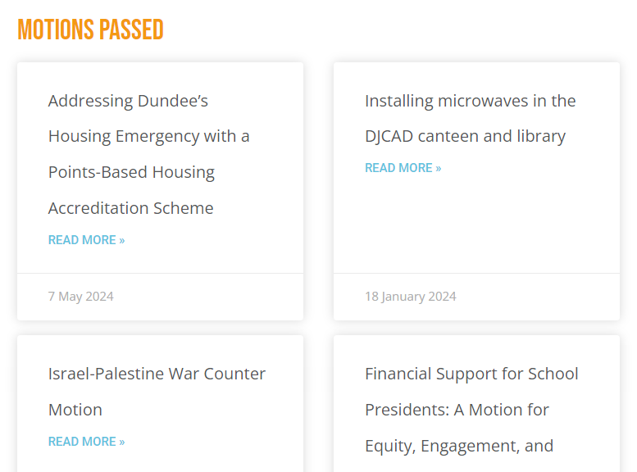
an association of the generality of elected students whose principal purposes include promoting the general interests of students relating to academic matters, student well-being, organize events and campus facilities etc

Slide 11
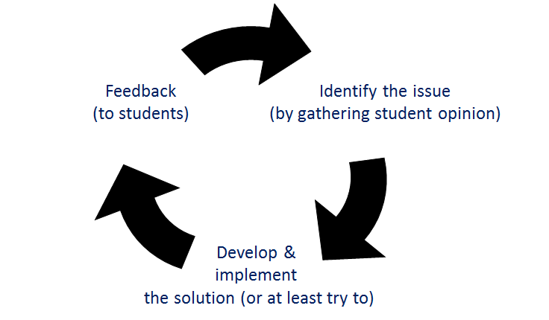
Enhancement through effective feedback
Completion of the feedback loop
Critical part of your role is
The information you collate, communicate and resolve all work towards enhancing the student learning experience at the university
Vital feedback goes forward and back

Slide 12
HOW TO COLLECT FEEDBACK
How can you get feedback from students?
Survey
Microsoft Teams
Email Groups
Informal discussion
Social Media

Slide 13
Pre-Meeting
Ensure you have feedback and understand the issues
Ensure you know what you want
Decide the best way to present it i.e do you need a paper?
Discuss it with key stakeholders
Get it on the Agenda
Post-Meeting
Re-read your notes and ensure they are accurate
Prepare a clear report
Circulate it to fellow Reps
Discuss it with key stakeholders
Decide on future action

Slide 14
General Advice
Attending
Need to participate
Know when, where and why
Know what you want
Who sits on the group?
Agenda – read it and add to it
Read the papers
Take notes/evidence
Don’t hijack and ambush
Remain respectful
Carry on outside of meeting
Chairing
Know your remit and rules and use them
Know the topics on the agenda
Be approachable and encouraging
Be fair but keep the meeting moving
Atmosphere can be set by the chair
Work in collaboration

Slide 15
Key policies and resources
University
Joint Agreement on representation
Student Partnership Agreement
Assessment Policy
External
SPARQS
QAA

Slide 16

Questions?

Slide 17


Slide 18
Achieving goals
Solution/Policy
Delegation and Collaboration
Implementation

Slide 19
Additional Support
DUSA
Enquiry Centre
Academic Skills Centre
Careers
Elected Executive
Academic appeals – Advice and Support advice@dusa.co.uk
Representation Team –vpr@dusa.co.uk
vpa@dusa.co.uk
Student Representative Council (SRC)
Direct access to services – sign posting
Cover health, wellbeing, admissions, academic support etc.
Live Smart guides
Learn Smart Guides
Toolkit
Advice on academic skills
Quality Academic Standards Team
Help find jobs
Interview skills
Job opportunities
DundeePlus

Slide 20

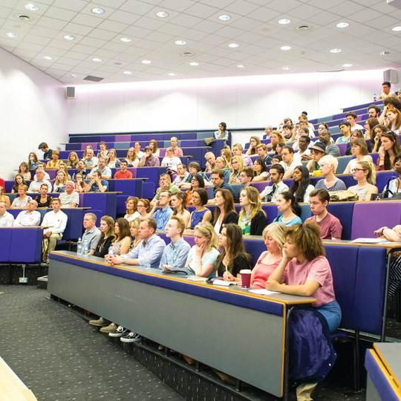

OUTCOMES
Explain why feedback is important and what role you play in the representation system
What to focus on and how to collect feedback
Analysing the feedback
How to effectively present feedback
How to feedback to students

Slide 21


Slide 22

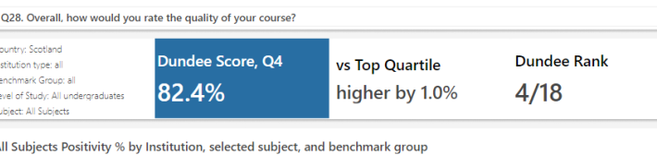
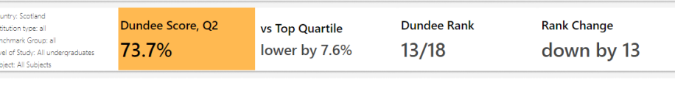
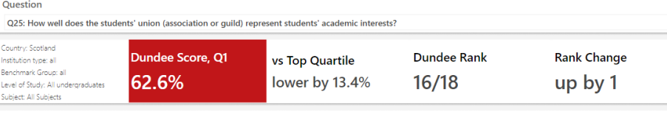
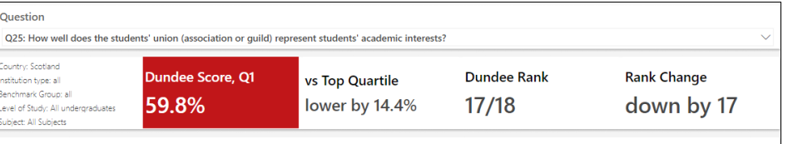

Slide 23
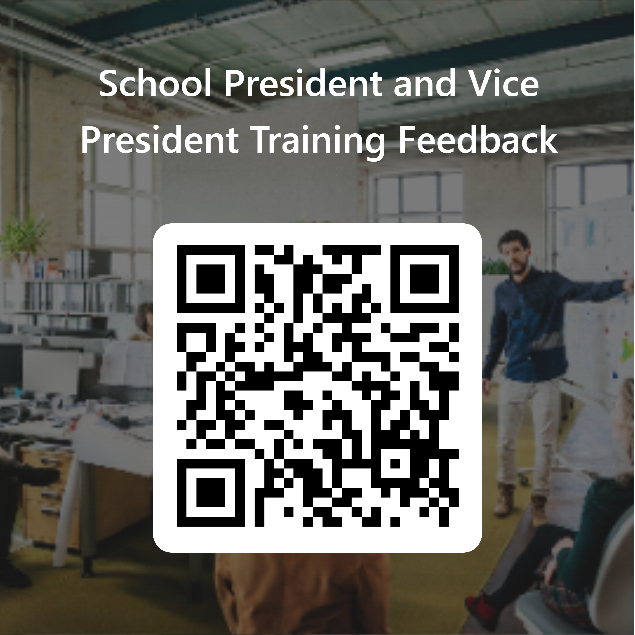
FEEDBACK TO US!
Thanks for attending! We welcome your thoughts on this training session.
Please fill out the survey from the link through the QR code.
Any further thoughts - please get in touch.
THANK YOU FOR COMING!!

