Slide 1
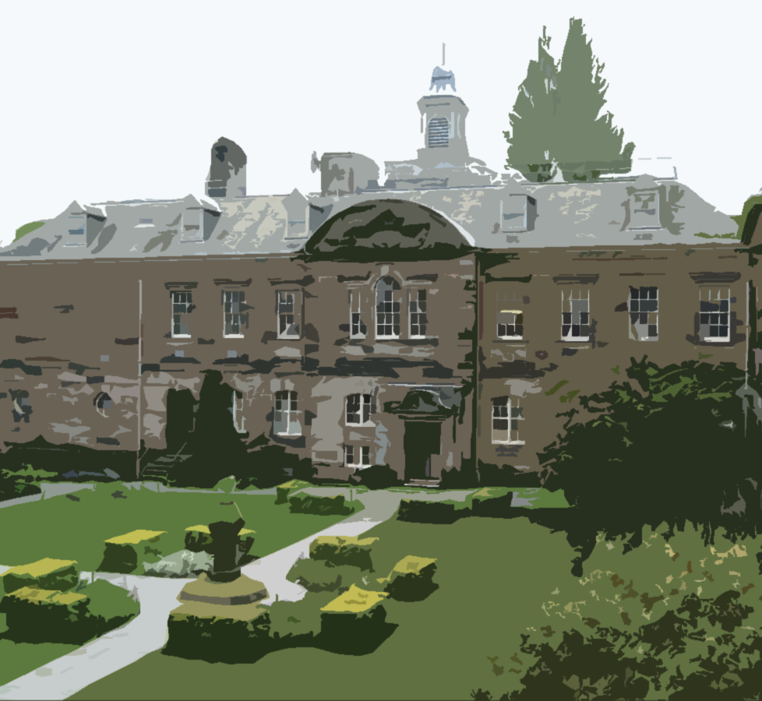

Student Representation
Core Training for incoming
CLASS REPRESENTATIVES

Slide 2
Outline and learning outcomes
The role and benefits of being a class rep
Learn about the communications cycle and how to use it
After today you should be able to:
Identify effctive ways to collect feedback from your fellow students
How to analyse feedback collected
Effectively present feedback to staff in a professional setting
Identify ways to keep your classmates’ informed of developments

Slide 3

The role and benefits of being a Class Rep
Representation is the process where one person or a group of people act, speak, or be present on behalf of another person or group.

Slide 4
As a class representative you will have the opportunity to:
Develop
Develop advocacy, communications, and meeting skills
Meet
Meet new people and network with different stakeholders
Gain
Gain a class rep certificate
Make
Make a real difference to your student experience, as well as a positive difference to other students’ lives
Enhance
Enhance your CV and employability

Slide 5
The Representation Structure
School President
Vice President
Class Representatives
Senior School Management (ADL&T/Dean/School Manager)
Staff and Module/Programme leads
Discipline Leads/ADL&T
School Board
Learning and Teaching Committee
Quality and Academic Standards Committee etc.
Student Representative council (SRC
Student and Staff Liaison Committee

Slide 6
LUCIE
Listen, Understand, Change, Implement, Evaluate

Slide 7

Communications Cycle
Stage One
Gather feedback from students
Stage Two
Prepare to present your feedback
Stage Three
Present your feedback to the right person(s) at the right time(s)
Stage Four
Feedback outcome(s) back to students

Slide 8



Student Voice
Why is feedback important?
Enhances student experience
Identifies what works well
Identifies areas of improvement
Allows collaborative development
Meets national quality arrangements

Slide 9
Closing the Feedback Loop
Introduce
Collate
Present
Solutions
Feedback
Notes:
LUCIE
Listen
Understand
Change
Implement
Evaluate

Slide 10
HOW TO COLLECT FEEDBACK
How can you get feedback from students?
What other ways might you use to gather feedback from students? (VLE, collaborate, discord etc.)
Survey
Microsoft Teams
Email Groups
Informal discussion
Social Media
Notes:
Exercise to get them think of ways to get feedback
Duration: 10 minutes
There are many ways which you can get feedback from your class
Exercise: Go through each of these methods in turn. Allow 60 – 90 seconds for students to write in the chat about the advantages or disadvantages of each method.
Due to COVID-19 online spaces are going to be the main ways of receiving feedback. What other platforms might a rep use, how might they use them?
Here are the training links for teams: Microsoft Teams Online Training Resources
https://support.microsoft.com/en-gb/office/microsoft-teams-video-training-4f108e54-240b-4351-8084-b1089f0d21d7?ui=en-us&rs=en-gb&ad=gb
Teams Demonstration
This covers: Notifications about recent activity, private chats, teams, meetings, files and apps
https://teamsdemo.office.com/

Slide 11
Collecting feedback
What questions should I ask to collect quality feedback?
Using good questioning technique will help you gain useful information.
There are 3 main types of question:
Closed
Open
Probing
Using well-structured questions will allow you to get specific and detailed information from your classmates

Slide 12

Confidentiality and personal data
Personal data only includes information relating to a person who:
  can be identified or who are identifiable, directly from the information in question; or
  who can be indirectly identified from that information in combination with other information.
Notes:
When collecting feedback from your peers, it is important to remember that sometimes you will be collecting personal data. For example, you may receive feedback that could specifically identify your fellow student to the staff liaison committee. It is important to bear this in mind, and we will go on to cover how to depersonalize feedback in the coming slides. Good practice would also be to delete the feedback messages once you have used the information in them. If in doubt – annonymous unless the student gives you permission to personalise it.

Slide 13
Presenting your feedback
Who? – know who you are presenting it to, know your audience
Why? – why is the evidence important
Outcome? – have recommendations prepared
Knowledge? – make sure you know what you are talking about
Notes:
Being a Class Rep isn’t about going to meetings and complaining!
Being a Class Rep is about having a constructive dialogue with the university around improving the learning experience

Slide 14
Feedback scenario
You’ve been waiting for
your mark and feedback on an
essay for six weeks. Finally, you get the feedback.
The common consensus in the class is that the small
bit of feedback that everyone got wasn’t particularly helpful and that the marks were not in keeping with how they had performed throughout the year. Several students approach you about
this issue. How do you resolve it?

Slide 15
Key meeting(s)
Discuss feedback
Seek views
Shape learning
External examiners
Student-Staff Liaison Committee
to enable staff to seek students' views on any aspect of the SLE via the Class Reps
to enable students to contribute to the shape of their learning experience through their Class Rep
to report and make recommendations to School committees and/or any other relevant University body
Notes:
Key meeting for Class Reps – one of the best and easiest times to pass on feedback and get solutions – good to have fresh feedback from students as you go into it. And of course feedback to your class afterwards. You can of course arrange your own meetings at any time in the year as necessary to do your job.

Slide 16



Meeting Etiquette
BE INFORMED
Location? Time? Date?
Always be ON time
Confirm availability
BE PREPARED
Bring a notebook/laptop to take notes
Think about how to present your data
AFTER THE MEETING
Report back to your classmates
Follow up on areas of concern
Notes:
SSLC Follow up (After meeting)
Report back to your classmates after the meeting
Email/Social Media/ Teams
Follow up on areas of concern
Talk to the staff involved
Feed back to your fellow students!
Links back to ensuring there is a good relationship – meeting etiquette is a key aspect

Slide 17

Presenting feedback
A
+
B
+
C
+
D
=
Effective Meetings
Assertive
Balanced
Constructive
Depersonalised
Notes:
A- understand the whole issue - don’t assume – talk to everyone
B- opposing opinons – why are they opposing – get both sides and deliever positives and negatives.
C- staff need to see the benefits – ensure you provide solutions and explain why things will be better if they act
D- make sure the feedback is anonymous – we also understand that you are in the class and may be passionate about the problem but when you go to staff you need to be neutral – you're a facilitator.
E- if you do all of the above the feedback will be effective.

Slide 18
Communication tips
Try to avoid interrupting others. Allow speakers to complete their thoughts before interjecting.
Try to use hand-outs or other visual aids to present detailed information or ideas.
Try to maintain open body language and try to avoid crossing your arms to show you are open to the contributions of others.
Try to act in an empathetic manner to others, even when you disagree with what they think.
Try to make occasional eye contact with speakers to show that you are interested and actively listening to what they are saying.

Slide 19
Additional Support
DUSA
Elected Executive
Enquiry Centre
Direct access to services – sign posting
Academic Skills Centre
Learn Smart Guides
Careers
Academic appeals – Advice and Support advice@dusa.co.uk
Representation Team –vpr@dusa.co.uk
Cover health, wellbeing, admissions, academic support etc.
Live Smart guides
Toolkit
Advice on academic skills
Help find jobs
Interview skills
Job opportunities
DundeePlus
Student Representative Council (SRC)
Quality Academic Standards Team
vpa@dusa.co.uk
Class Rep handbook

Slide 20
Elected Executive Emails
President | Manaswi (Manu) Budhathoki
VP Academia | Dani McFawns
VP Representation | Nicole Okoro
VP Student Welfare | Nihin Akanni
VP Community | Alishba Ahmad
VP Fundraising | Esther Ajayi-Akinsulire
VP Student Activities | Ravi Baral
president@dusa.co.uk
vpa@dusa.co.uk
vpr@dusa.co.uk
vpsw@dusa.co.uk
vpc@dusa.co.uk
vpf@dusa.co.uk
vpsa@dusa.co.uk

Slide 21
School President Emails
Business | Louise McClearyun
Dentistry | Caleb Hunter
DJCAD | Ivy Guo
Health Sciences | Lucas Fonseca
Humanities, Social Sciences and Law | Dan Kirchin
Life Sciences | Banga Liepute
Medicine | Morgan Muncey-Buckley
Science and Engineering | Bradley Schreiber
president.business@dundee.ac.uk
President.dentistry@dundee.ac.uk
President.djcad@dundee.ac.uk
President.healthsciences@dundee.ac.uk
President.hsl@dundee.ac.uk
President.lifesci@dundee.ac.uk
President.medicine@dundee.ac.uk
president.scieng@dundee.ac.uk

Slide 22
Representation Structure: Students’ Association
Student Representation Council (SRC)
DUSA Executive
School Presidents
SRC Councillors
DUSA
Students
Class Reps/Vice President Feedback

Slide 23
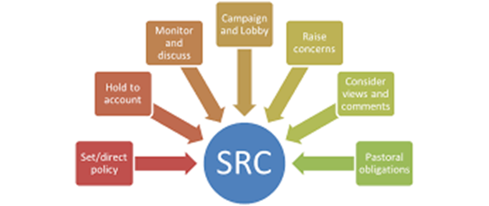
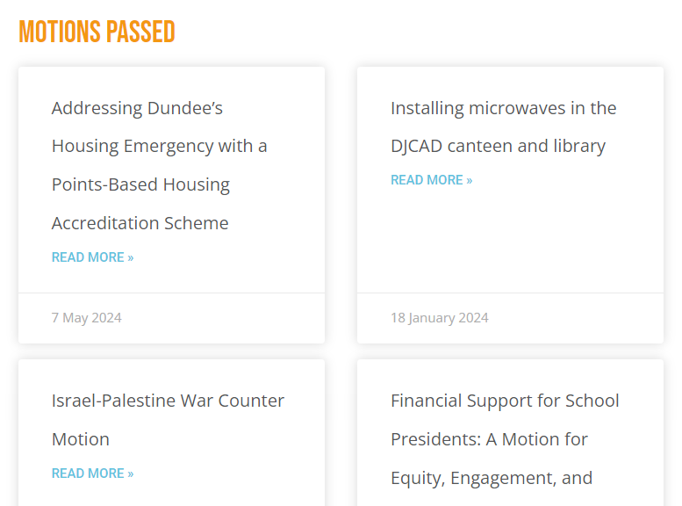

an association of the generality of elected students whose principal purposes include promoting the general interests of students relating to academic matters, student well-being, organize events and campus facilities etc

Slide 24



Slide 25

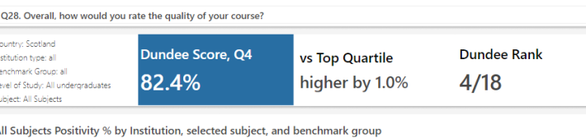
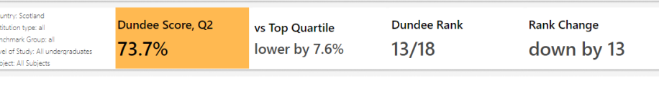
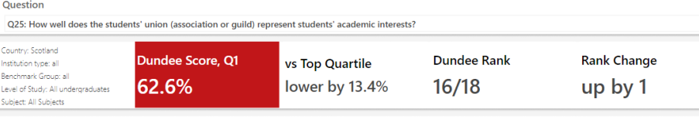
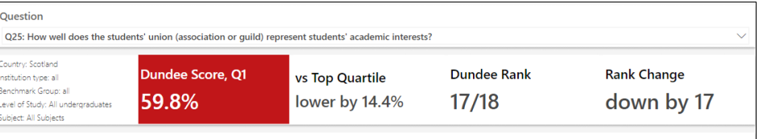

Slide 26

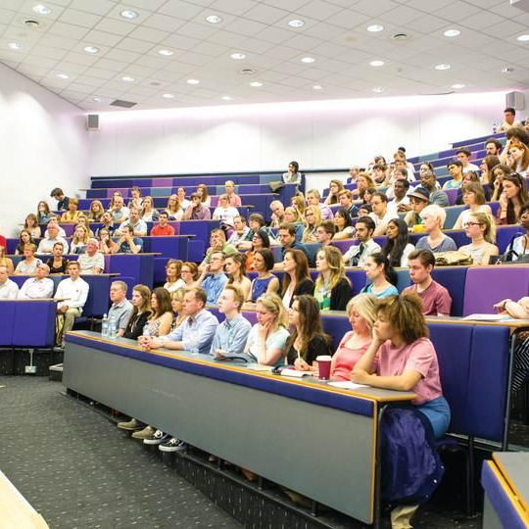

Outcomes
Explain why feedback is important and what role you play in the representation system
What to focus on and how to collect feedback
Analysing the feedback
How to effectively present feedback
How to feedback to students

Slide 27

Questions?

Slide 28
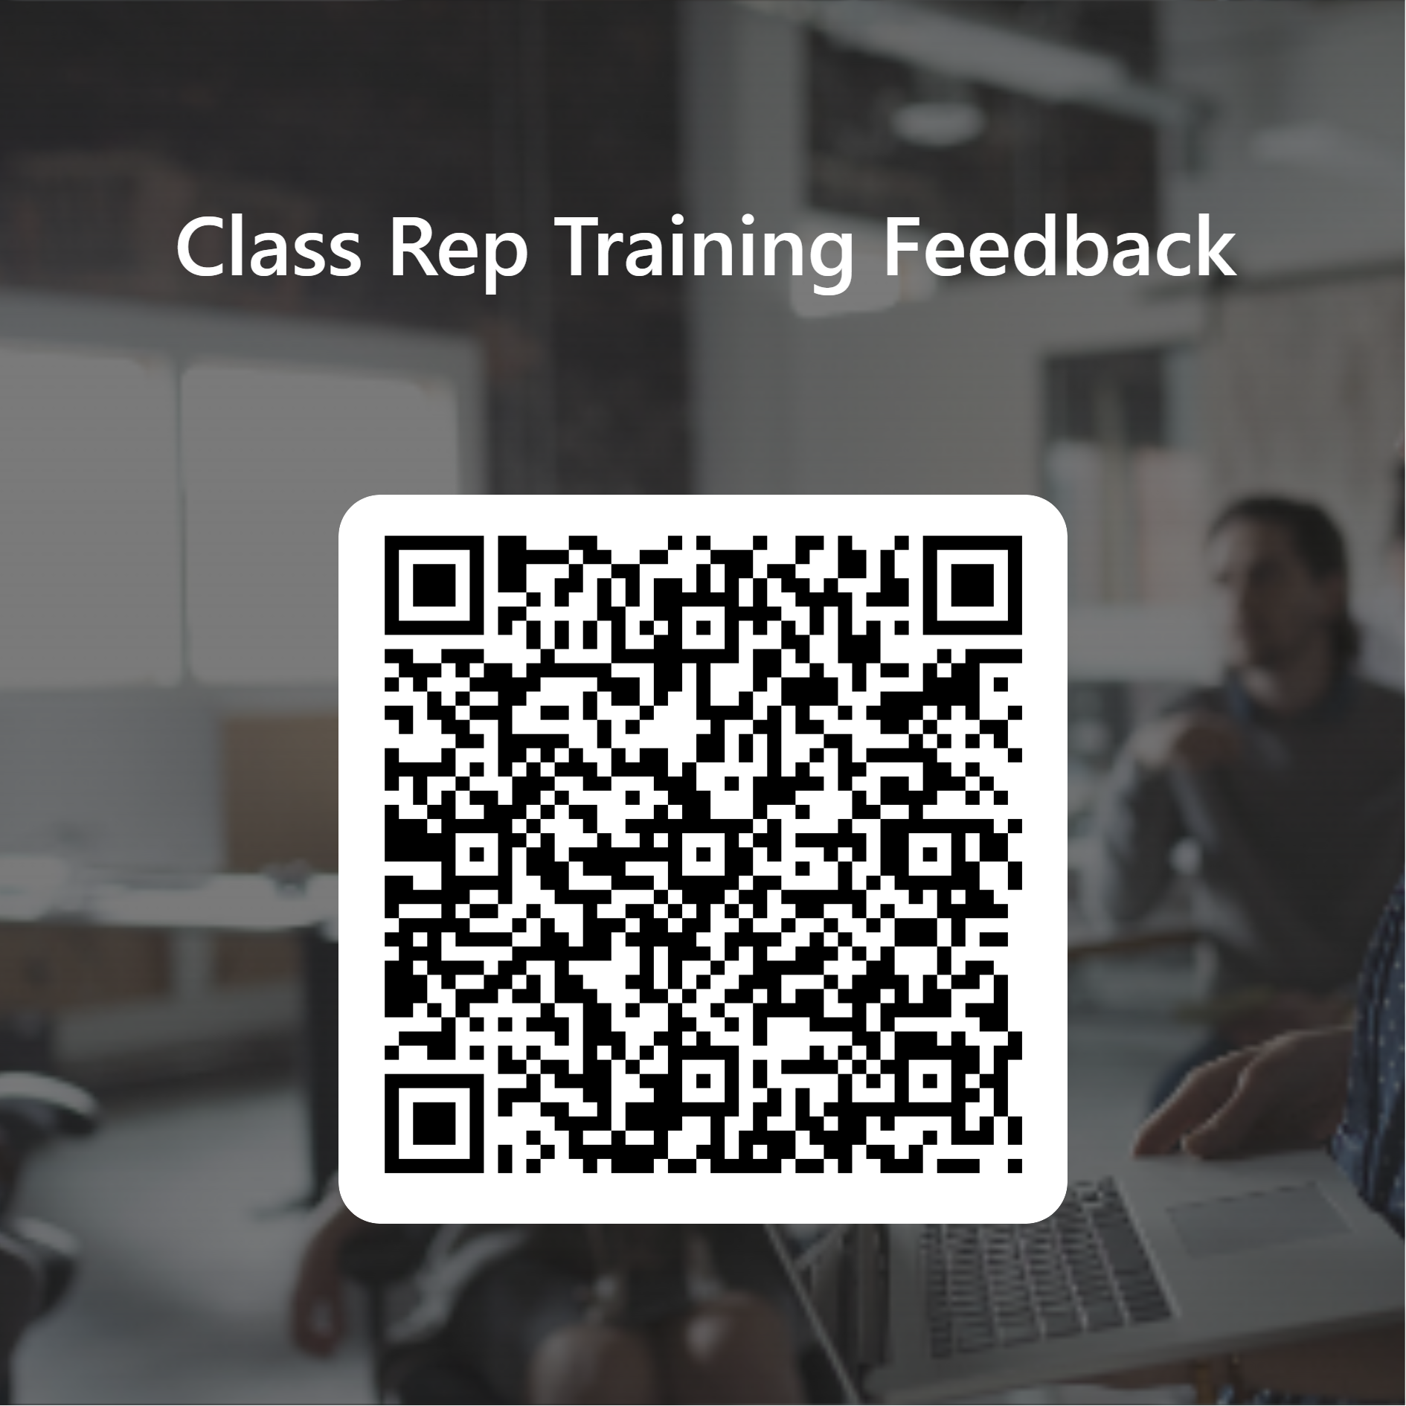
Feedback to us!
Thanks for attending! We welcome your thoughts on this training session.
Please fill out the survey from the link through the QR code.
Any further thoughts - please get in touch.
Thank you for coming!!

