Slide 1

Dundee University Sunday League Football Club AGM.
2020-21

Slide 2
Agenda
Financial Report (2020-21).
Constitutional Amendments.
Committee Elections (2021-22).

Slide 3

Financial Report

Slide 4
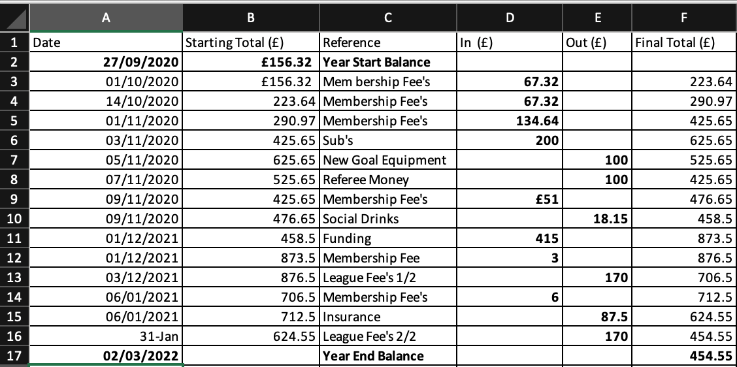

Slide 5
Overview:
Began the year with £156.32.
- £106.32 was carried over from previous year + £50 DUSA Starter Pack.
Memberships (01/09/2020– 01/03/2021):
- Received 38 signups - £323.28.
- But we have over 60+ players registered on the teamsheets.
- This number is expected to rise with the initiation of the AGM.
Ending 2020-21 Academic Year with £454.55.

Slide 6
Kit Drive:
Overall Cost - £1,357.
Purchased 25 Snoods for £125 (£5pp) and sold 19 for a profit of £1 (£6pp).
- Made a loss of £11 but club retains 6 snoods for match awards.
Purchased 19 Match Tops for £342 and sold at cost (£18pp).
Purchased 15 Tracksuits for £525 and sold at cost (£35pp).
Purchased 16 Jumpers for £496 and sold at cost (£31pp).
Received no complaints as to quality of kit and we are eager to retain our relationship with the supplier.

Slide 7
Equipment:
Initial Expenditure of £100 in November to secure:
- Nets x 2, pegs x 20 and clips x 50.
- First Aid kits, thermometers and sanitiser wipes x 2.
Due to the pandemic, we have had no reason nor a chance to spend club funds elsewhere. However, we received a successful funding application from DUSA December for £415. This has allowed us to purchase:
- League Fee’s and Insurance for the Midlands Amateur Football Association.

Slide 8
Constitutional Amendments:
Aims:
Put the roles of ’Kit and Equipment Coordinator’ and ‘Junior/Senior Social Secretary’ on an official footing.
Increase the diversity and openness of the society to all members regardless of age, ability or gender.
Amendments:
1.3(a) – Insert ‘age’ and ‘or gender’.
3.1 – Insert ‘a Kit and Equipment Coordinator, Junior Social Secretary and Senior Social Secretary’.
3.6 – Insert ‘3.6 The Kit and Equipment Coordinator shall be responsible for the organization, maintenance and purchase of all Dundee University Sunday League Football Club attire and equipment’.
3.7 – Insert ‘3.7 The Junior Social Secretary shall be responsible for the management of the social media pages and focusing on helping ensuring new members are welcomed into the community whilst supporting the Senior Social Secretary in their duties.
3.8 – Insert ’3.8 The Senior Social Secretary shall be responsible for the organisation of the end of season awards ceremony, large social events and working to ensure the club receives sponsorships.

Slide 9
Voting Link:
https://forms.gle/DwQy5qg8xaYrvusU9

Slide 10
Committee Elections (2021-22).
Nominations:
President:
‘A’
Vice-President:
‘B’.
Treasurer:
‘C’.
Secretary:
‘D’.
Kit and Equipment Coordinator:
‘E’.
Junior Social Secretary:
’F.
Senior Social Secretary:
‘G.’
Note:
Can still vote for R.O.N (Re-open Nominations) if you feel candidate is unfit for their position.
Candidates will have no more than 2 minutes to deliver a speech on why they are suitable for the role.
Voting Link - https://forms.gle/YP9V9ZwvNR2mZgho8.

Slide 11

Results.

